Slide 1


Slide 2
Text

Slide 3
Terminology
Font
A font is a graphical representation of text that may include a different typeface, point size, weight, color, or design.
Typeface
A typeface is a design that defines the overall look of characters. Arial and Times New Roman are examples of typefaces.

Slide 4



Typefaces I
Georgia
Times
Times New Roman
Serif
has extra details at the end of the main strokes of the letters
Sans-serif
has straight ends and therefore has a much cleaner design
Monospace
every letter in a monospace typeface
has the same width
Arial
Verdana
Helvetica
Courier
Courier New

Slide 5
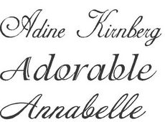
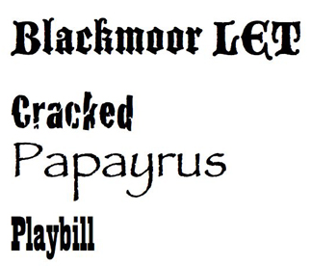
Typefaces II
Cursive
either has joining strokes or other cursive
characteristics, such as handwriting styles
Fantasy
usually decorative and often used
for titles. They're not designed for
long bodies of text

Slide 6
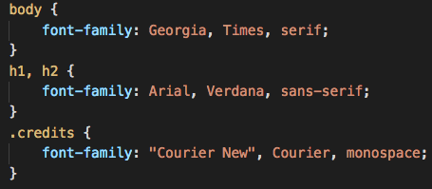
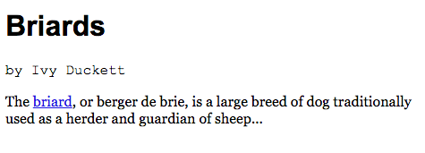
Specifying Typefaces
The font-family property is used to specify which font should be used
Value is the name of the font
List of fonts can be defined
Good practice is to have a generic font in the font list

Slide 7
Exercise

Slide 8
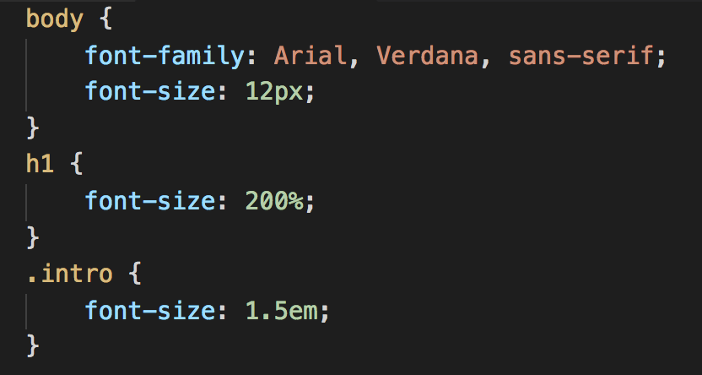
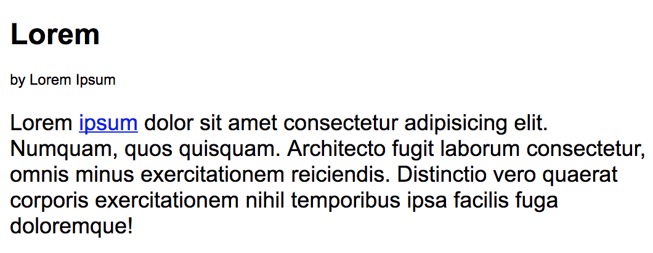
Font Size
The font-size property enables specifying font size
Common ways for specifying font size:
pixels
percentages
ems
Default font size in browser is 16px

Slide 9
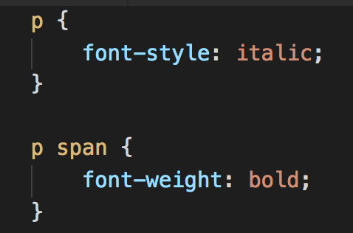
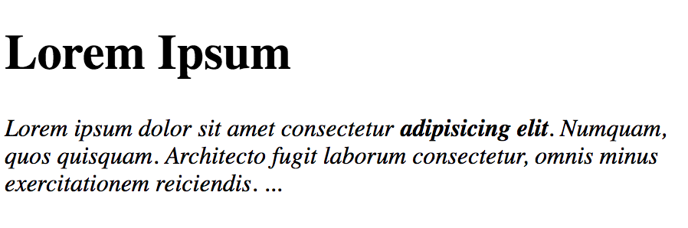
Weight and Style
font-weight is used for making the text look:
normal
bold
font-style is used for making the font look:
normal
italic
oblique

Slide 10
Exercise

Slide 11
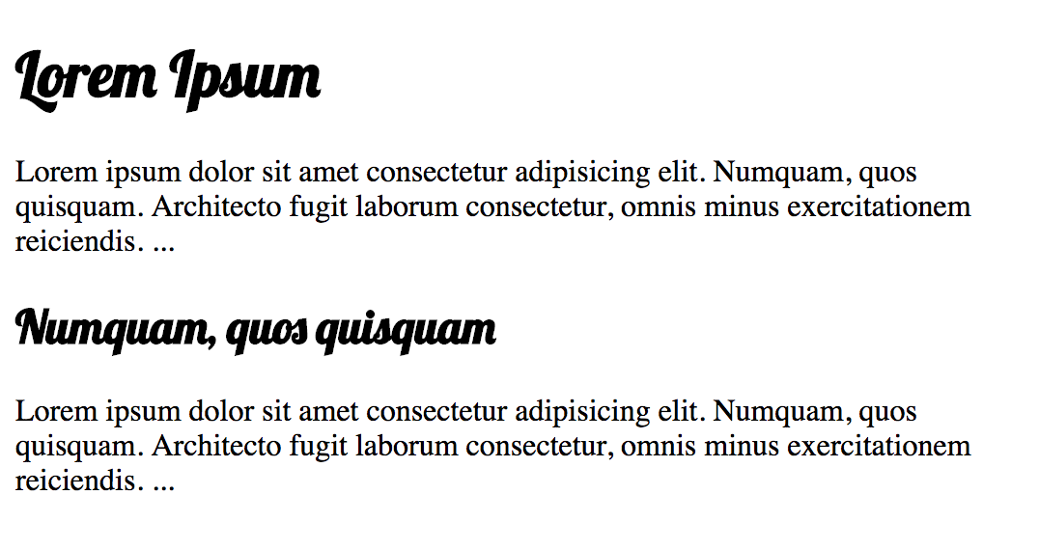
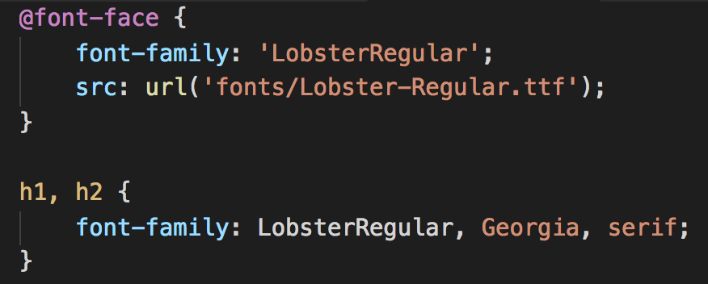
Using More Fonts
Use @font-face to include fonts on page
define font name using font-family
src is used to reference font file
Find fonts at
https://fonts.google.com
www.fonts.com
www.fontsquirrel.com
www.fontex.org
www.openfontlibrary.org

Slide 12
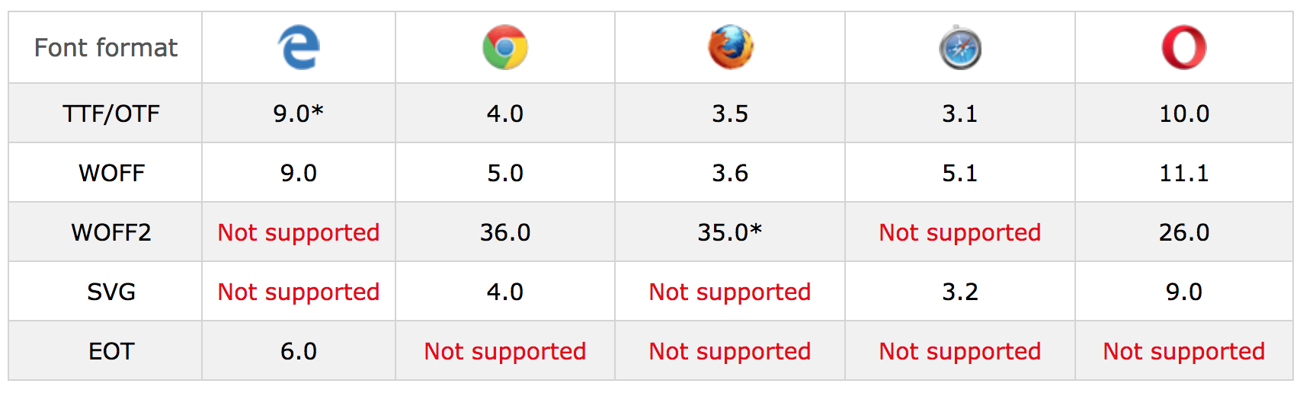
Font Formats Browser Support

Slide 13
Exercise

Slide 14
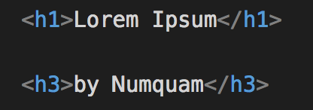
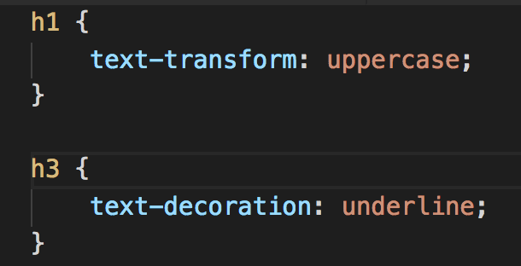
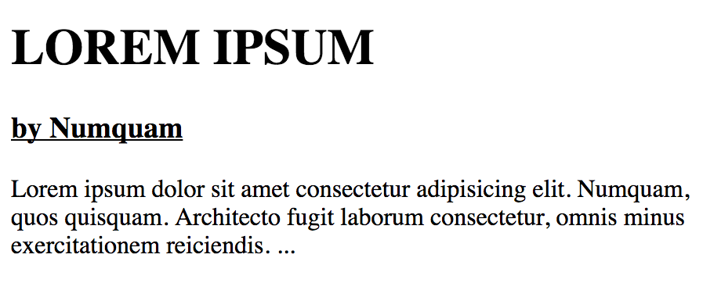
Transform and Decoration
text-transform is used to change the case of text to:
uppercase – all characters are uppercase
lowercase – all characters are lowercase
capitalize – each word starts with a capitalized letter
text-decoration specifies the decoration added
to text:
Underline
Overline
Line-through
Blink

Slide 15
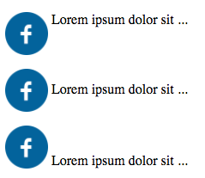
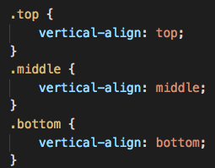
Text Align
text-align is used to control text alignment which can be
Left
Right
Center
Justify
vertical-align used on inline elements
Baseline
Sub
Super
Top
vertical-align is similar to HTML align attr.
Text-top
Middle
Bottom
Text-bottom

Slide 16
Exercise

Slide 17
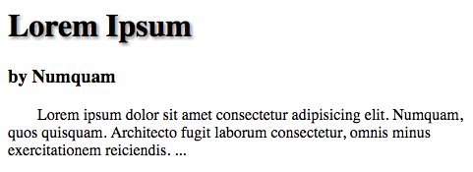
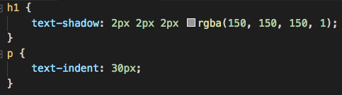
Shadows and Indentation
Use text-indent to indent the first line of text
Specify the indent size by using px or em
Indent can be positive or negative
Use text-shadow (CSS3) for dropping text shadow
A value can take three lengths and color
Make your life easier and use an online generator:
https://css3gen.com/text-shadow

Slide 18
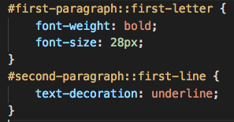
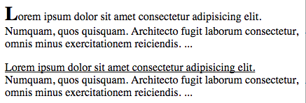
Pseudo-selectors I
Select part of an element or an element based on context
pseudo-classes
pseudo-elements
Defined at the end of a selector
Some pseudo-elements are
::after
::before
::first-letter
::first-line
::selection

Slide 19
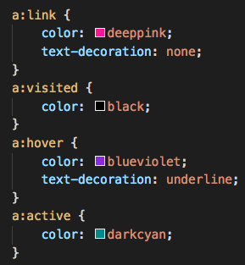
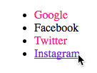
Pseudo-selectors II
Some of pseudo-classes are
:link
:visited
:hover
:active
:focus
:disabled
:required
:first-child
…

Slide 20
Exercise

Slide 21
Summary
There are properties used for changing the font, size, weight, style, and spacing.
There is a limited choice of fonts that you can assume most people will have installed.
If you want to use a wider range of typefaces, there are several options, but you need to have the right license to use them.
You can control how text is aligned (left, right, center or justified). It can also be indented.
You can use pseudo-classes to change the style of an element when a user hovers over or clicks on text, or when they have visited a link.

Slide 22
References
Typeface - https://goo.gl/1nbR6A
Font Types - https://goo.gl/hMpH2z
Pseudo Selectors - https://goo.gl/a7gEUM

